Slide 1
Honors Biology Cumulative Review Slides
Dr. Keller

Slide 2
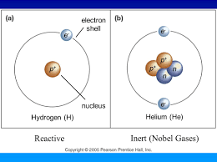
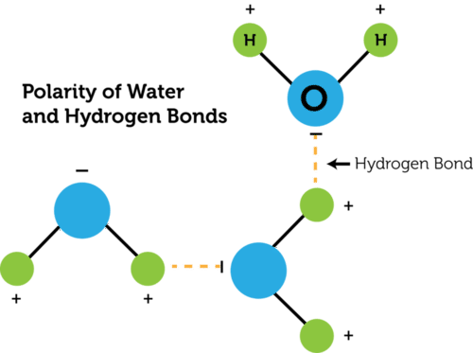
Chemistry of life
Isotopes: same element, different number of _______
Inert atoms: those with an outer electron shell that is _____
Ionic bonds: between ____ (loss or gain of _____). Break in water.
Covalent bonds: _____ of electrons. Strong in water.
Hydrogen bonds: between polar molecules. H₂O; the O is ____. Weak bonds but collectively strong. Example in DNA:
Notes:
Neutrons
Full
Ions (loss or gain of electrons)
Sharing of electrons (strong in water)
Water, O is partially negative, interacts with partial positive on H
H-bonds between N-bases

Slide 3
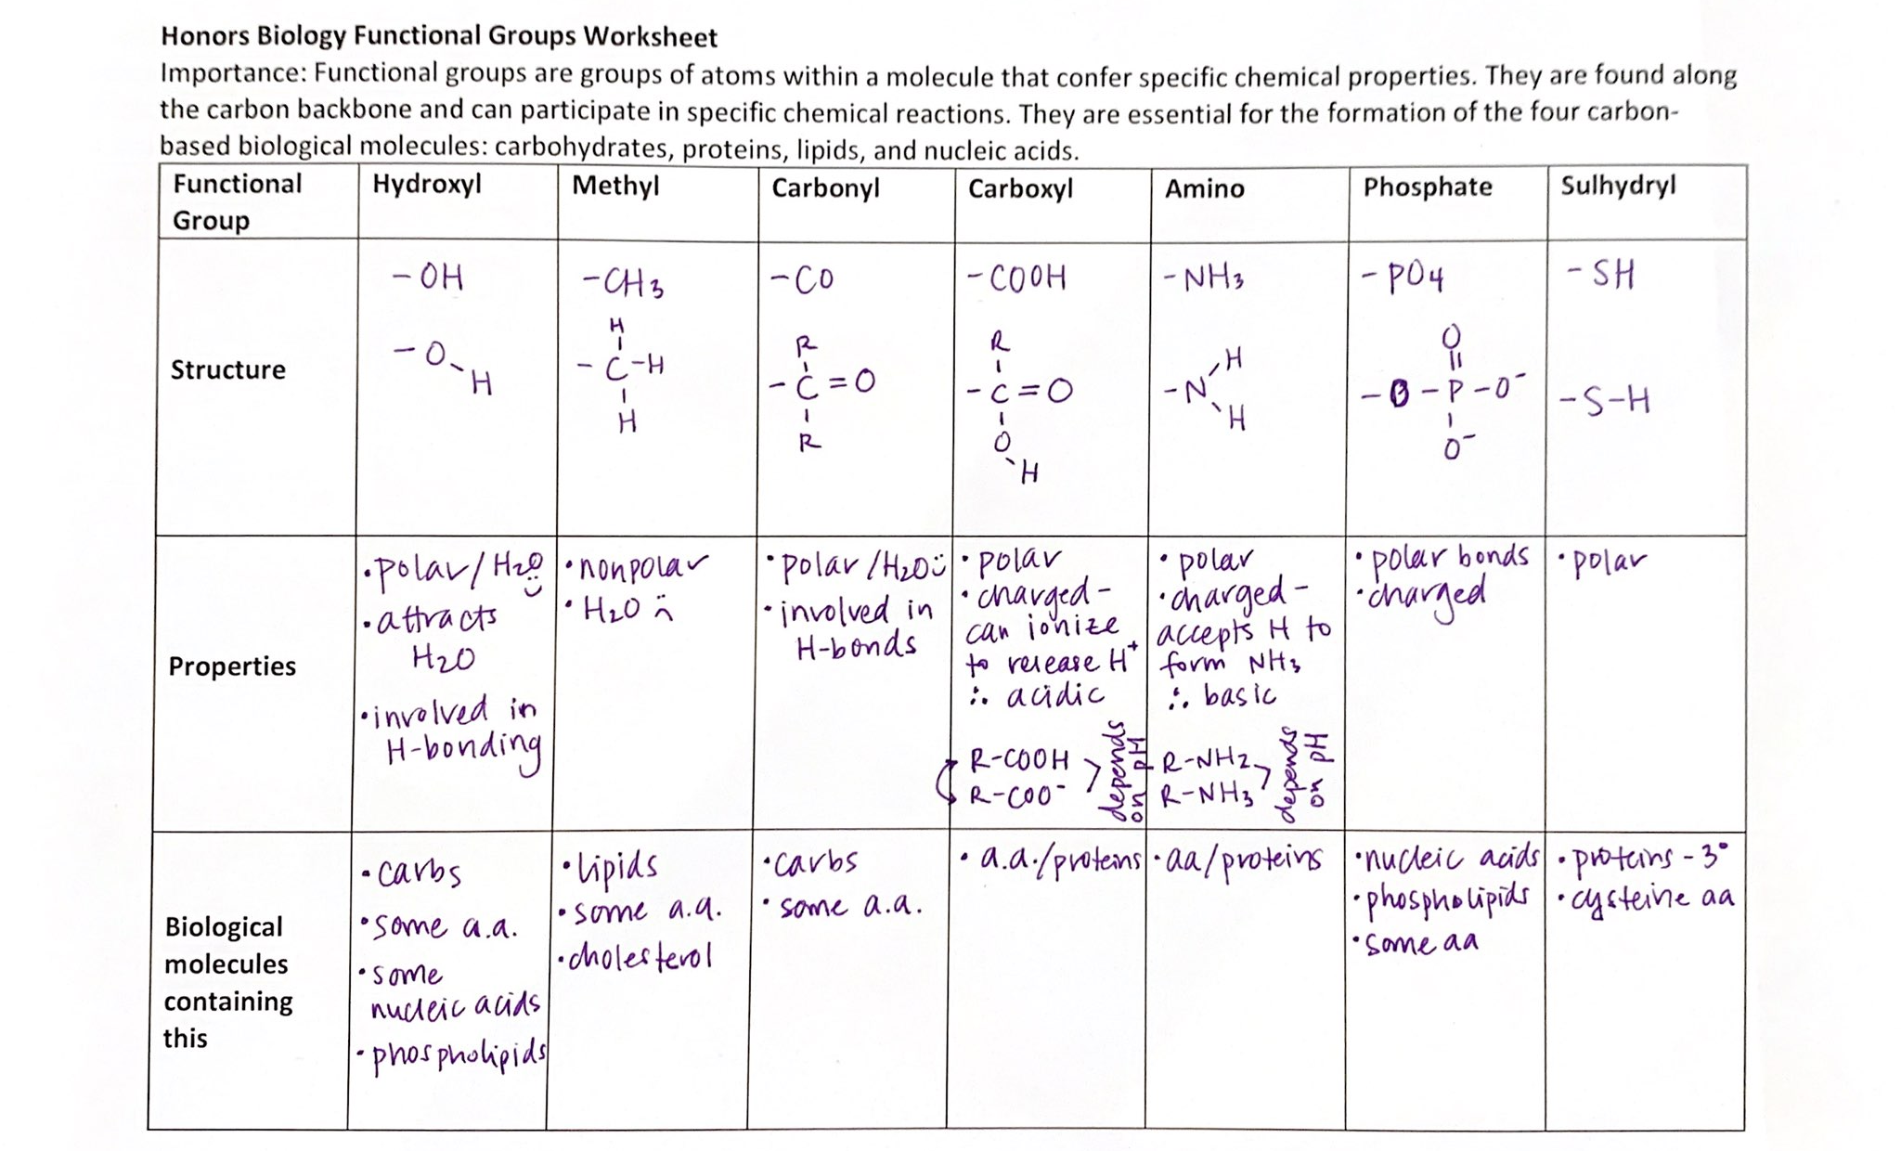

Slide 4
Biological Molecules
Polysaccharides (sugars): CH₂O. Glucose.
Storage for plants/animals ___/___; structure plants/animals ___/___
Lipids: water insoluble, nonpolar, energy, membranes, hormones
Phospholipids are _____
Steroid hormones are ____
Saturated vs. unsaturated. Arctic animals want more _____
Proteins: made of ____ held together by _____
Primary, secondary, tertiary (held by ____) , quaternary
Nucleic Acids: monomers are nucleotides made of ___,___,___
DNA- ___ OH is essential for adding new nucleotides. _____ bonds.
RNA- 3 kinds
Notes:
Plants: starch/cellulose; animals: glycogen/chitin
Phospholipids- amphipathic, nonpolar tails, polar heads
Steroid hormones- nonpolar, small, sneak through membrane
Saturated = with hydrogens (solid at RT); unsaturated = double bonds/kinky/ more liquid
Primary (aa amino + carboxyl), secondary (alpha helix, beta sheet – H-bonds of backbone); 3 (R-groups) S-S, ionic, hydrophobic, H-bonds
Nucleotides: n-base, 5-C sugar, phosphate group
DNA – ds, deoxyribose sugar, 3’OH . Phosphodiester bonds.
RNA – ss, ribose sugar (two OH) / tRNA, mRNA, rRNA

Slide 5
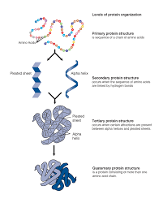
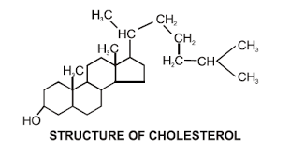

Slide 6
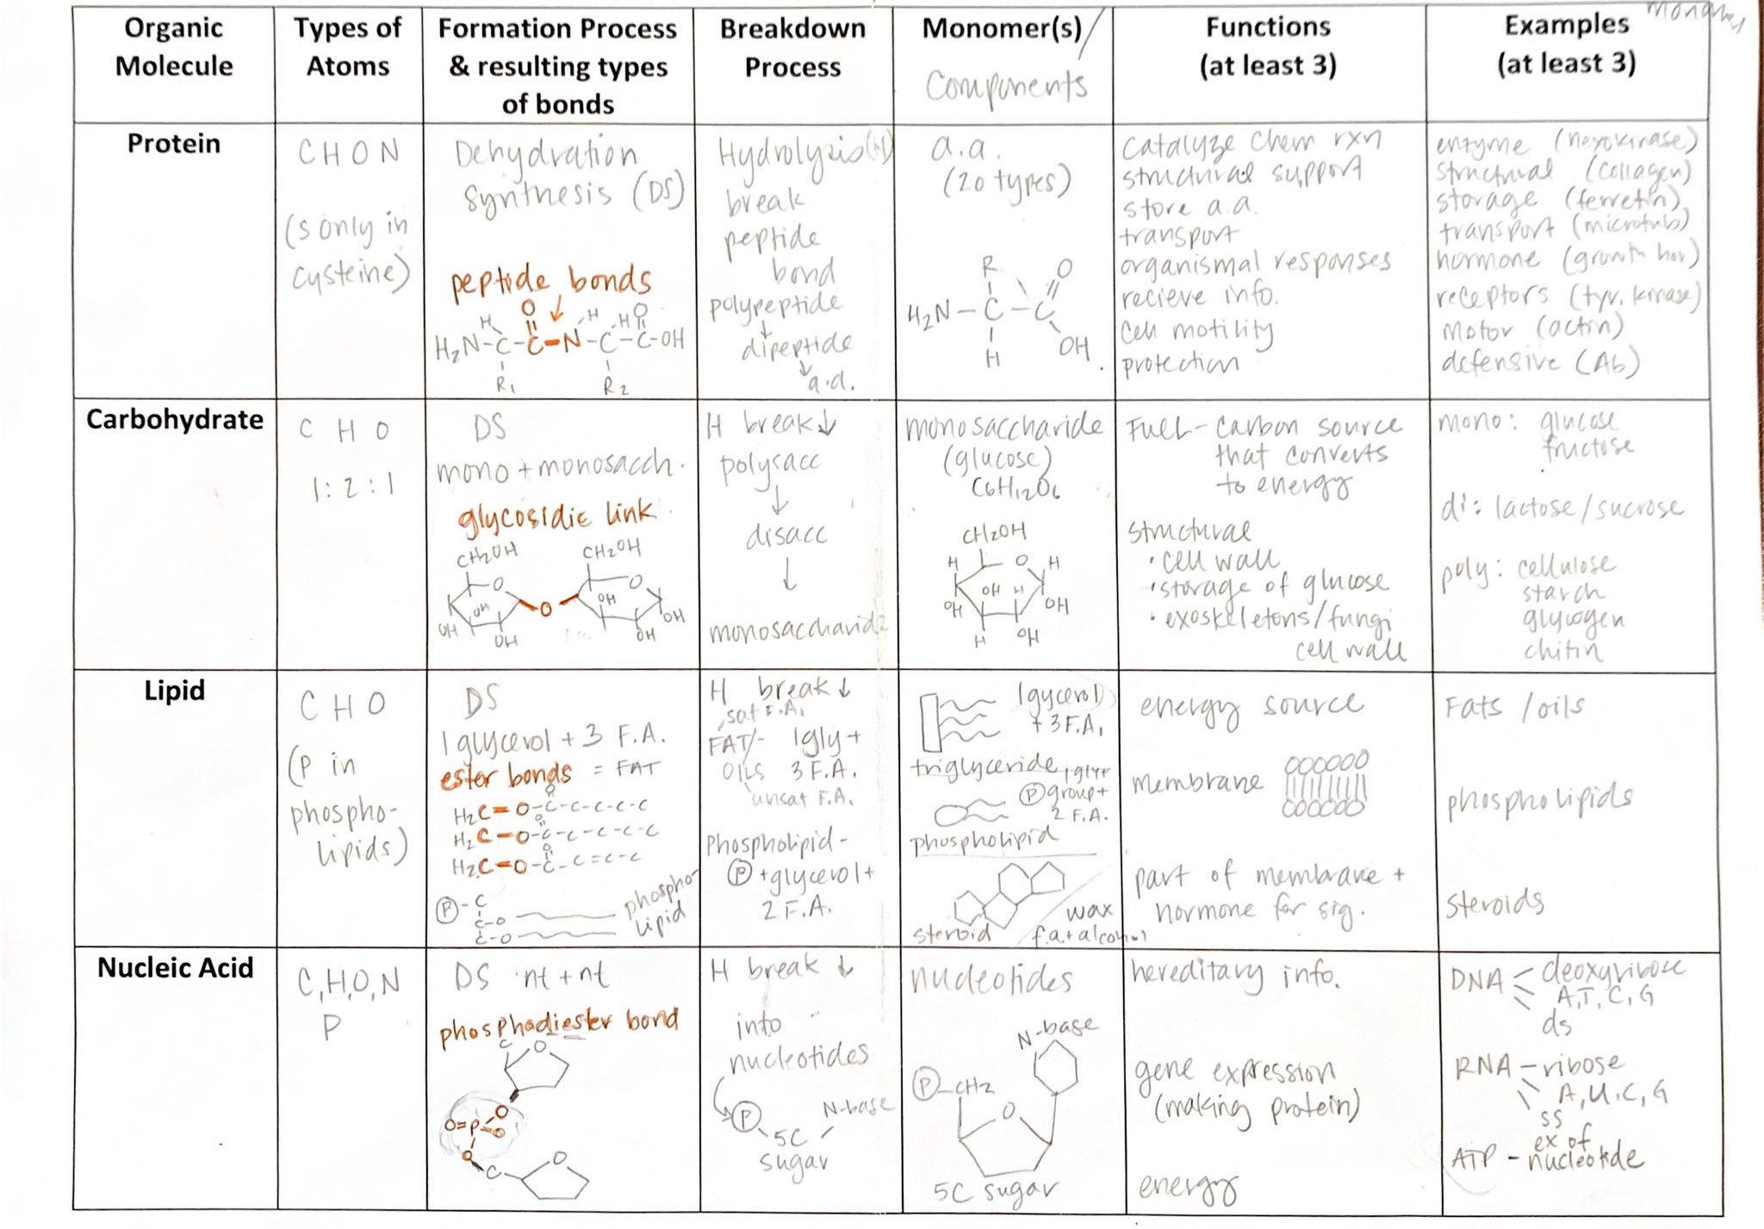

Slide 7
Membranes
Phospholipid bilayer: selectively permeable, fluid mosaic model
Membrane proteins, phospholipids, glycoproteins, glycolipids, cholesterol
Osmosis: hypertonic, hypotonic, isotonic (which is saltiest?). Water moves ___ its ____ gradient and its _____ gradient
Facilitated diffusion vs. simple diffusion
Channels vs. carriers vs. cotransporter
Passive vs. Active transport
Endocytosis (phago and pino) vs. exocytosis
Notes:
Glycoproteins = ID tag, glycolipids = signaling; cholesterol like glue at high temp and to keep it fluid at low temps
Hypertonic
Water potential and concentration
Channels – pore; carrier has conformational change; cotransporter (build up gradient and then use it to funnel something across)

Slide 8
Tour of the cell
Prokaryotic vs. eukaryotic
SA:V ratio: cells better at diffusion if this # is ___
Cell Theory: 1)___2)___3)___
All cells have: 1)___ 2)____ 3)____4)___
Animal vs. plant cells: only animal cells have____: only plant ____
Endosymbiont theory says what? Evidence?
Endomembrane system: membranes/organelles work to package, transport lipids/proteins (nuclear env, ER, golgi, lysosomes, vacuoles, vesicles).
Nuclear Env: double-membrane, pores, nucleolus inside (rRNA), lamina (IF)
Notes:
Pro: small, circular, no mem-bound organelles; Euk: larger, linear chr, mem-bound organelles
Larger = better diffusion
All organisms made of cells, cells basic unit of cell, all cells from preexisting cells
PM, ribos, nucleic acid, cytosol
Animals: centrioles, centrosomes, cilia & flagella; plants, cell wall, plasmodesmata , central vacuole, chloroplasts
Theory that explains how mitochondria and chloroplasts came about (pro eating but not digesting another pro)
EVIDENCE: ribos, circular DNA, fission division, enzymes on inner membrane,

Slide 9
Tour of the cell cont.
Ribosomes: protein making factories (large and small subunit)
Free- for making cytosolic proteins
On rER- for making membrane proteins, or proteins that will be exocytosed
ER: smooth (making lipids) and rough (making proteins)
Golgi: cisternae folds, cis and trans, modifies lipids/proteins, adds sugars
Lysosomes: low pH, enzymes, digests
Mitos (in ____ euk cells) /Chloros:
Mitos: use ___ to make ___
Chloros: use ___ to make ___
Cytoskeleton:
Actin – smallest, firm twisted ropes (cytokinesis)
Microtubules- large, hallow tubules (railroad tracks); basis for cilia and flagella
Intermediate filaments- medium size, nuclear lamina
Extra cellular stuff: cell wall, extracellular matrix, cellular junctions
Notes:
ALL
Mitos: use O2 to make ATP
Chloros: use light and CO2 and water to make sugar!

Slide 10
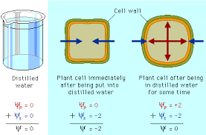
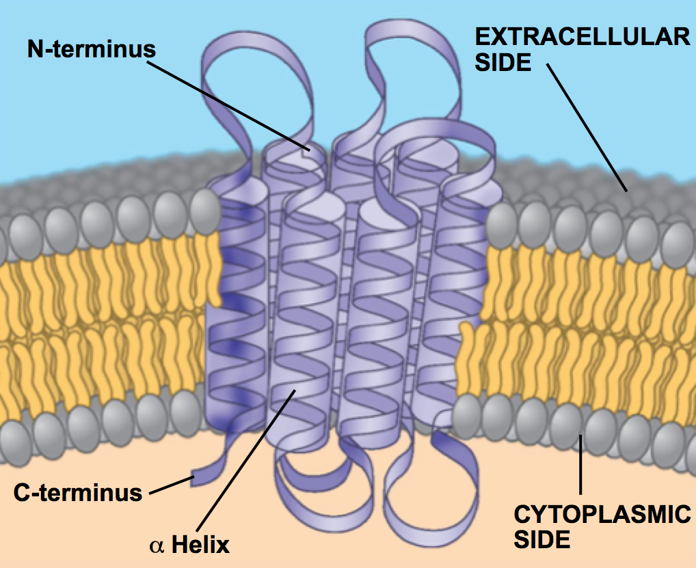
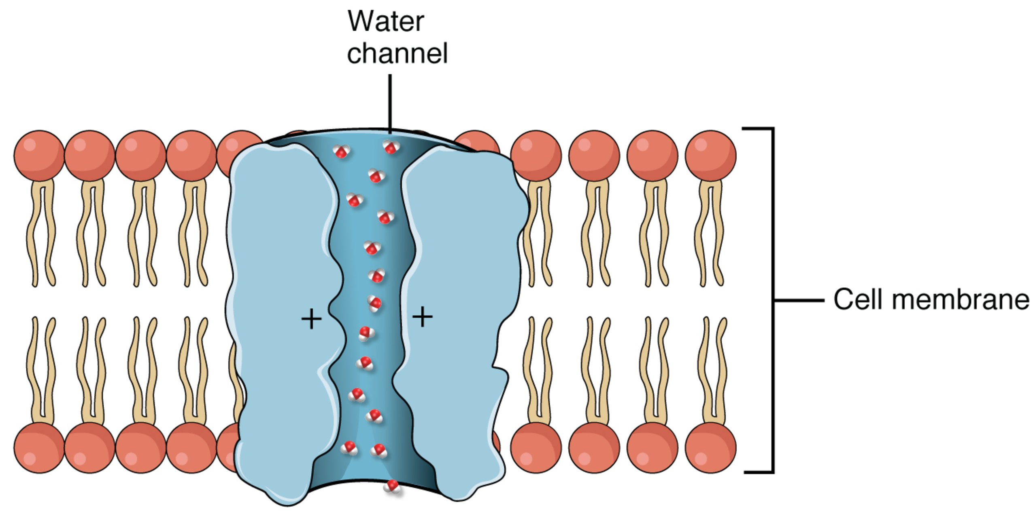
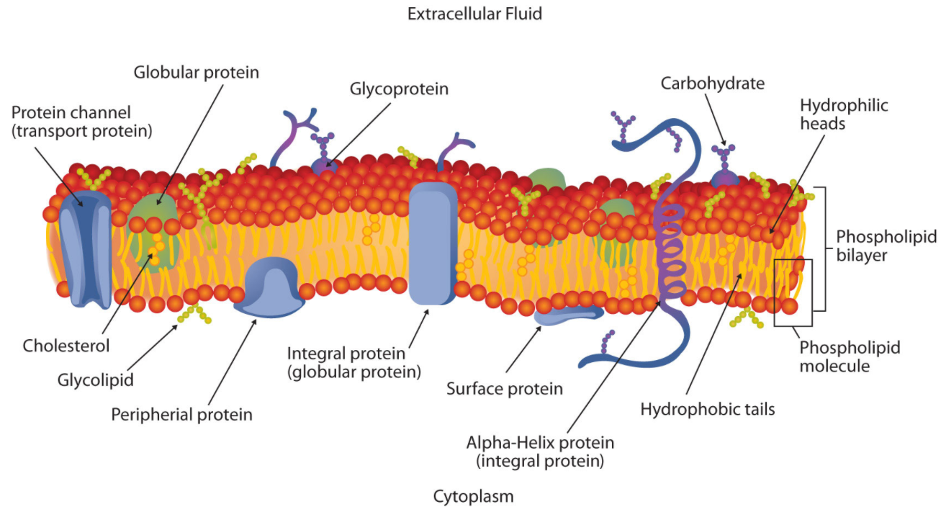
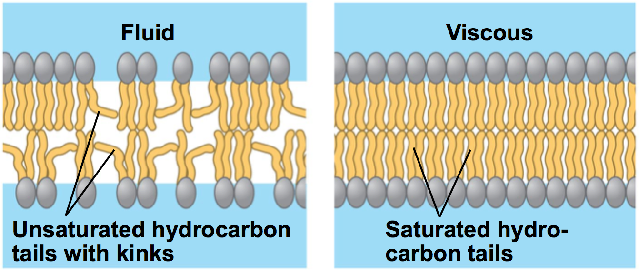

Slide 11
Energy and enzymes
Catabolic, exergonic, spontaneous, -∆G vs. anabolic, endergonic, +∆G
Thermodynamics: 1st law: E can’t be ____ or ____; 2nd law: E toward _____; E usually lost as ____ in organisims
3 kinds of work cells do: chemical, mechanical, transport
Enzymes: speed up reactions by reducing the _____
Enzymes:
Substrate-specific: induced fit model
Not consumed/changed: remain unaffected
Altered by environment: they are proteins are shape depends on pH, temp, etc .
Denaturation causes what?
Enzyme inhibitors: competitive or noncompetitive (allosteric binding), feedback inhibition, cooperative
Notes:
Created nor destroyed; entropy tends to increase (more disorderd state)
Activation energy of reactions
Back to primary structure so loses ALL 3D shape of the protein (shape determines binding pockets, determines function)

Slide 12
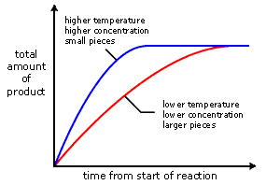
Enzyme graphs

Slide 13
Cellular Respiration
C₆H₁₂O₆ + 6O₂ → 6H₂O + 6 CO₂
Glucose is oxidized → loses e⁻/H⁺ to become CO₂
Coenzymes accept these electrons and carry them
Catabolic, break down glucose, store E in bonds that make ATP
Anaerobic respiration: requires no O2, in the cytoplasm (glycolysis and fermentation).
Fermentation: regenerate NAD+ levels so glycolysis cont to make same ATP
Lactic acid- humans (gives on lactic acid)
Alcoholic- yeast (gives off CO2)
Aerobic resp: needs O2, in mitochondria, Krebs, ETC, releases lots of ATP
3 stages:
Glycolysis: break down glucose (6C) into 2 (3C) pyruvates
Pyruvate Oxidation + Krebs: breaks down pyruvate into CO2
ETC + chemiosmosis: NADH/FADH2 oxidizes and donate electrons to ETC, H+ pumped into inner membrane space, ATP synthase turns to make ATP as H+ ions go down their concentration gradient. Oxygen is final electron acceptor!

Slide 14
Photosynthesis
Anabolic, endergonic, taking CO2 in and converting light E into bonds of glucose
Chlorophyll: pigment absorbs red/blue, reflects green.
Stomata: gas exchange (O2 out as waste, CO2 in for Calvin Cycle)
Light Dependent Reactions: needs sun, in thylakoids, splits water, releases O2, generates ATP (ATP synthase) and NADPH (final e acceptor).
ETC II – first to pump H+ into thylakoid space
ETC I – second to be final electron acceptor for NADP+
ATP synthase – generate ATP from H+ concentration gradient
Light Independent Reactions: no sun needed, in stroma (Calvin Cycle), CO2 fixed into organic molecules, forms glucose after two rounds, use ATP and NADPH!
CAM and C4 plants: avoid photorespiration (use O2 instead of CO2)
CAM – temporal separation of steps (collect CO2 at night, store it as something else for day)
C4 – spatial separation of steps (Calvin cycle occurs in bundle sheath instead of mesophyll)

Slide 15
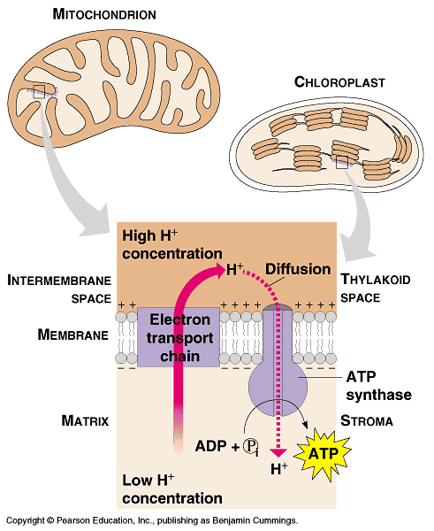

Slide 16
Cell Cycle
Mitosis: G1-S-G2-PMAT-cytokinesis
Spindle made of _____, humans have __ chromosomes.
Homologous chromosomes: diploid vs. haploid
Cell cycle checkpoints: G1, G2, M checkpoint during ____ phase
Oncogenes vs. tumor suppressors
Bacteria use ______
Meiosis: only in _____; point is to _____
Two rounds of division: separate _____ and then _____
3 ways of increasing genetic diversity
Notes:
MT, 23 pairs
M checkpoint during metaphase.
Oncogene – overactive –pedal to the medal. Tumor suppressor – checkpoint, normally stops/ mutated (can’t stop)
Binary fission (no nucleus)
Only in sexual reproduction; make haploid gametes (separate diploid homologous chromosomes)
Homo chromos and then sister chromatids
Crossing over, independent assortment, random fertilization

Slide 17
DNA
Griffith (DNA transformation), Hershey and Chase (viral DNA, not protein), Chargaff (A=T; C=G), Franklin (phosphate backbone), Watson and Crick (base pairing)
Structure: ____parallel, ___ on outside, ____ on inside
Centromere vs. telomere
Replication: need ___ for adding. Mesleson and Stahl proved _____
Starts at the ______
Helicase, primase, DNA ligase, DNA polymerase (which is proofreading?)
Always replicates new strand in ____ direction; creates _____ fragments
Notes:
Anti, Phosphate and sugar backabone making it (-), N-bases on inside by H-bonds
3’OH; semi-conservative replication
Origin of replications (many for linear euk chromosomes)
5-3’ ; okazaki fragments

Slide 18
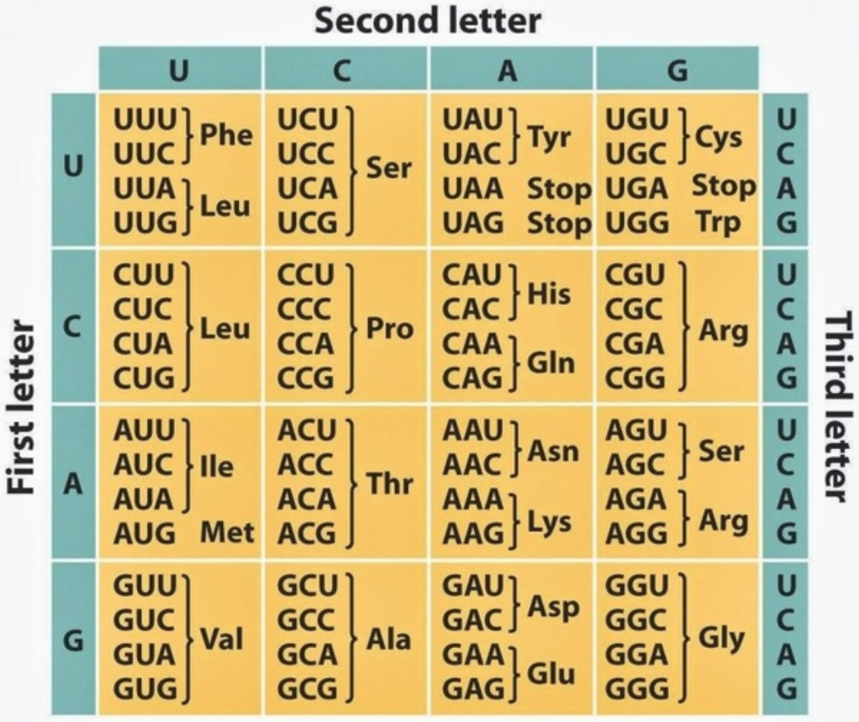
Central Dogma (DNA to RNA to Protein)
Transcription: enzyme is _____; happens in _____
Reads DNA start of gene; makes mRNA
Splicing and adding of 5’ cap and 3’ polyA tail
Translation: enzyme is _____; happens in _____
Starts at start codon: reads 3 bp = 1 codon. One codon = 1 aa.
Stops at stop codon
Chart is the mRNA. If given DNA → mRNA first!
Mutations: silent, nonsense, missense
Notes:
Txn: RNA pol, in nucleus
Trans: ribo, in cytoplasm
Nonsense = premature stop
Missense = different aa

Slide 19
Gene Regulation
Bacteria genetic diversity: transformation, transduction (viruses), conjugation
Why is eye cell different from liver cell? Same DNA, different ____
Prokaryotic gene regulation:
Operon: genes of similar function, transcribed together with repressor and activators binding DNA elements.
Lac operon: usually off, induced to turn on when Lactose present
Trp operon: usually on, repressed to turn off when enough Tryptophan is present
Eukaryotic gene regulation: occurs at many levels – DNA accessibility, Transcription, RNA processing, RNA stability, Translation, and protein activity
Notes:
Differential RNA expression

Slide 20
Genetics
Gene defined as: ______; Allele defined as: ______
Genotype ____ determines phenotype
True-breeding vs. hybrids
Dominant vs. recessive: which one skips a generation on pedigree?
Monohybrid cross: Pp x Pp = ____ phenotypic ratio
Dihybrid cross: PpYy x PpYy = ____ phenotypic ratio
Mendel’s two laws:
Law of segregation – two alleles separate during meiosis (gamete formation)
Law of independent assortment – alleles assort independently if far apart or on different chromosomes
Notes:
Sequence of DNA that encodes for a protein; a version or specific sequence of a gene that gives a specific phenotype
Pairs of alleles
True breeding = homozygous; hybrid = heterozygous
Monohybrid = 3:1 ; dihybrid = 9:3:3:1 ratio

Slide 21
Genetics Cont.
Sex-linked: genes on X-chromosome
X^{A}Xª x XªY → what happens?
Gene linkage: if genes nearby on same chromosome, get unexpected #s of progeny due to lack of crossing over between them.
Recombination frequency: #recombinants/total x 100%
Gene mapping: use recombination frequencies to determine where genes are on a single chromosome
Nondisjunction: bad separation during meiosis resulting in gametes with ______. Worse if occurs in _____.
X-inactivation: females have two X chromosomes and males have only one so females have random inactivation (reduced expression) from one X.
Notes:
Punnett square: half daughters affected, half sons affected
Anueploidy (abnormal numbers of chormosomes).
Anaphase I where HC separate.

Slide 22
Non-mendelian genetics
Incomplete dominance: offspring have mixed phenotype (WW x RR)
Codominance: offspring have BOTH phenotypes (WW x RR)
Multiple alleles: blood type (I^{A}, I^{B}, i) , each person has TWO (ex: I^{A}I^{B})
Blood type is based on glycoproteins on surface of red blood cells
Universal donor: _______ ; acceptor _______
Pleiotrophy: single gene disrupted = multiple phenotypes
Polygenic: many genes control a single phenotype
Epistasis: unexpected ratios 9:3:4 instead of 9:3:3:1 due to one gene expression being dependent on another
Environmental factors: temperature (bunnies); vitamin C (scurvy)
Notes:
Donor - O
Acceptor - AB

Slide 23
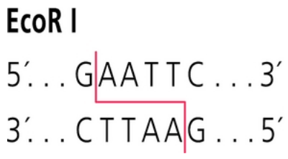
Biotech
Restriction enzymes: naturally occurring in bacteria. Cut DNA at specific sequences called restriction sites. Sticky ends.
Bacterial plasmid: small circular piece of dsDNA, separate from the cell’s chromosome.
Promoter, Target gene, Antibiotic resistance gene, origin of replication
Gene Cloning: PRC desired gene of interest, cut the ends with restriction enzymes, cut plasmid with same enzymes. DNA ligase to put target gene into plasmid. Bacterial transformation. Select for growth of bacteria on appropriate antibiotic plate.
Animal cloning: put nucleus of an egg cell into a donor cell that has been anucleated and grow it up. Only genetic material is from original female.

Slide 24
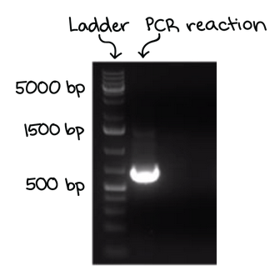
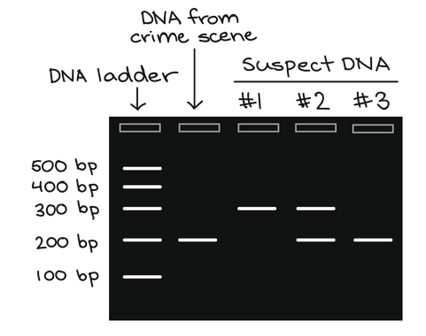
Biotech cont.
PCR: polymerase chain reaction
Make millions of copies of a specific sequence of DNA
Sequence determined by your chosen primers
Need template DNA, primers, heat tolerant DNA polymerase
Denature (separate DNA), annealing (primers bind), extension (DNA synthesized)
Gel Electrophoresis: allows us to visualize and quantify the size of DNA. Smaller DNA runs faster, compare to known size on ladder.
DNA Sequencing: determining the sequence of DNA
Forensics/DNA fingerprinting: compare DNA bands at crime scene to known samples

Slide 25
Evolution
Lamarck – use and disuse, inheritance of acquired traits (wrong!)
Artificial selection: selective breeding for desirable traits
Darwin and Wallace: Natural selection – those with favorable adaptations tends to survive and reproduce at higher rates (due to those traits).
Descent with modification: unity of life on earth, common LUCA
Evidence of evolution: BEF V. HAM- biodiversity, embryology, fossil records, vestigial structures, homologous structures (due to _____ evolution), analogous structures (due to ____ evolution), molecular biology
Notes:
Homologous structures: due to divergent evolution (common ancestor diverging away)
Analogous structures: due to convergent evolution (similar traits due to similar env. Factors)

Slide 26
Evolution Cont.
Allele frequency: # of A alleles/total # alleles. Can calculate directly if you have numbers for each genotype
Microevolution: changes in allele frequency over time
Macroevolution: new species due to changes in allele frequencies over time
Allopatric speciation: new species forming due to geographic separation
Sympatric speciation: new species forming within one geographical area
5 causes of microevolution:
Random mutation
Non-random mating (selective mating)
Migration
Natural selection (stabilizing, directional, disruptive)
Genetic drift – change in allele frequency due to random or chance event (worse in small populations: founder’s effect, bottleneck effect)

Slide 27
Hardy-Weinberg Equilibrium: a way to measure if populations are evolving or not by comparing allele frequencies over time.
In Drosophila the allele for normal-length wings is dominant over the allele for vestigial wings (vestigial wings are stubby little curls that cannot be used for flight). In a population of 1,200 individuals, 360 show the recessive phenotype. How many individuals would you expect to be homozygous dominant and heterozygous for this trait?
p = frequency of dominant allele
q = frequency of recessive allele
p + q = 1
p² = frequency of homozygous dominant genotype
2pq = frequency of heterozygous genotype
q² = frequency of homozygous recessive genotype
p² + 2pq + q² = 1
Notes:
q2 = 360/1200 = 0.3
q = 0.55
p = 1-0.55 = 0.45
Homozygous recessive = q2 x pop
Heterozygous – 2pq x pop
Homozygous dominant = p2 x pop

Slide 28
Biodiversity and classification
3 domains: archae, bacteria, eukaryia
KPCOFGS:
Binomial nomenclature: Linneaus, Genius species
Ancestral vs. derived traits: older vs. newer

Slide 29
Prokaryotes and early earth
Gradual chemical evolution hypothesis: environment on earth allowed for synthesis of amino acids, proteins, nucleic acids, first protocell with membrane (Miller Urey experiment)
Bacteria shapes: cocci, bacilli, spirlli
Diverse metabolism: photoautotroph, photoheterotroph, chemoautotroph, chemoheterotroph
Why archae more close to eukaryia?
Gram + vs. Gram – stain?
Bacteria only, peptidoglycan cell wall on outside (gram +). Easier to treat with antibiotics
Notes:
Bacteria – peptidoglycan cell wall, Archae (histones, extremeophiles, many RNA pol, introns)

Slide 30
Classification
Protists: grab-bag of eukyaria, algae, animal-like, plant-like, fungi-like, many single celled, small
Fungi: eukaryotic, chitin cell wall, made of hyphae, extracellular digestion and absorption (no photosynthesis)
Plants: holdfast to roots, diffusion to vascular tissue, cuticle, leaves, gas exchange with stomata, lignin, embryo protection, etc.
Bryophytes → pterophytes → gymnosperms → angiosperms
Alternation of generations (plant life cycle alternating between haploid gametophyte and diploid sporophyte)
Xylem, phloem, RAM, SAM, mycorrhizae, plant hormones

Slide 31
Animals
Blastula: stage in development with hallow ball of cells, folds into to make glastrula
Protostome vs. deuterostome: proto = mouth first vs. anus first
Coelom: true body cavity lined with mesoderm
Invertebrates: porifera, cnidaria, platyhelminthes, nematods, molluscs, annelids, arthropods, Echinodermata
Vertebrates: tunicates, lancelets, jawless fish, cartilaginous fish, bony fish, lob—finned fish, amphibians, reptiles, mammals
Notochord (vertebrate)
Dorsal nerve cord
Pharyngeal slits
Post-anal tail

Slide 32
Cell Communication
Molecular switches- phosphorylation and GDP/GTP
Endocrine, paracrine, neuronal, contact-dependent, autocrine
Ligand binds receptor, receptor changes shape, signal transduction, cellular response
Ligands
Hydrophobic/small/nonpolar – steroid hormones, gases (bind intracellular receptors)
Hydrophilic/larger/protein/polar – proteins, water-soluble ligands (bind cell-surface receptors
Ligand-gated ion channels, G protein coupled receptors, receptor tyrosine kinases
Second messengers- calcium, cAMP (amplification of the signal downstream of ligand-receptor binding)

Slide 33
Endocrine system
Hormone- secreted chemical signal carrying by blood stream
Ligand binds specific receptor on target cells
Hypothalamus-pituitary- neurocrine to pituitary command center
Pancreas- alpha cells secrete glucagon (breakdown glucose) and beta cells secrete insulin (take-up glucose and store as glycogen)
Adrenal glands- epinephrine flight of flight response
Pineal- brain for melatonin
Thymus- T-cell production
Thyroid- metabolism and homeostasis
Ovaries and Testes- estrogen and testosterone

Slide 34
Immune System
Innate vs. adaptive immunity- non-specific vs. highly specialized cells
Inflammatory response: chemical signals, increased blood flow, leaky capillaries, phagocytic clean-up
Phagocytes vs antigen-presenting cells
B-cells: express and secrete antibodies (humoral response)
T-cells: express T-cell receptors bind APCs (cell-mediated response)
Helper T-cells vs. Cytotoxic T-cells
Memory cells

Slide 35
Nervous System
Peripheral vs. CNS- brain and spinal cord are central
Sensory, inter, motoneurons- (simple reflex circuit)
Neuron structure: dendrite, soma, axon (myelin), synaptic terminal
Action potential: stimulation, Na+ open flows in = depolarization, Na+ close, K+ open flows out, repolarization, hyperpolarization, Na/K pump to restore cell -70mV resting potential
Sympathetic vs. parasympathetic: stimulates/fight and flight vs. relaxation of the body

Slide 36
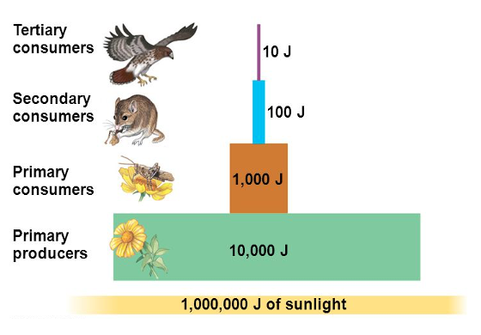
Ecology
Population growth: (birth rate - death rate) x #individuals
Logistic growth: rate = r_{max}N(K-N/K)
r_{max}= maximum growth rate, K= carrying capacity, N= population size
Exponential growth: rate = r_{max}N
Trophic levels: built on primary producers (lose ~10% efficiency)
Ecological niche, fundamental niche, realized niche
Keystone species- more important than # suggest
Succession:
Energy flow: production efficiency = net secondary prod x 100% / energy not assimilated as feces.
Energy flows in and out of systems, nutrients cycle within systems
Water (evaporation/ppt) , Carbon (biomass, CO2 → sugar), Phosphorous (taken up by producers), Nitrogen (nitrogen fixation)

